Slide 1
Learning from Data and Neural Nets I
Notes:
This module is the beginning of our discussion on learning from data. The discussion, comprising several modules, culminates in a discussion of neural, starting with unsupervised learning.

Slide 2
Machine Learning Pictorially
INGREDIENTS
PRODUCT
ML
Model
An Application
Data
(often, a lot)
… that classifies or regresses

Slide 3
Learning Goals
Use k-means clustering
Use support vector machines
Describe basic NN Architecture
Apply Kohonen Nets
Notes:
We will discuss a fairly wide array of learning technologies in this segment, all of which learn from data. The last part will be the first portion of the neural net part of the course.

Slide 4
Learn from Data
i.e., to classify, to predict, ...
Complex hypothesis that fits well but does not generalize well –vs.– vice versa
E.g., polynomial vs. straight line
…
Notes:
We want systems to learn from data so that we can understand the data, and to predict behavior with input other than the given data. You can think of data as part of the input/output of a (probably complex) function (a means of giving an output value for every input value), with random displacements (presumed to be “noise”). Our task is to determine the function—or possible functions that best fit the data.
The problem is accounting for noise. For example, suppose that we observe the following data:
input vector (3, 4)—output 5.1;
input (5, 12)—output 13.3; and
input (8, 15) —output 16.7.
It is possible to fit these exactly with a function f(x, y) = …, which might be a little complicated in form but, more importantly, would not be what we want. This would be overfitting. Overfitting in learning is like the following example: You observe that John worked for 10 hours on a presentation and got promoted, Jill 15 hours and did not, and Jane 3 hours and did. And what you learned from this is “If you work 10 hours or 3 hours (or close to either) on a presentation, you get promoted, and if you work 15 (or close), you don’t. This is poor learning.
A desirable fit (though not the only one) to the problem above would be g(x, y) = √(x² + y²). This assumes noise relative the real I/O
input (3, 4), output 5;
input (5, 12), output 13; and
input (8, 15), output 17.
We generally look for a continuous and smooth function that maps input to output.
There is an interesting theorem that says, essentially, that for any given desired approximation accuracy a (e.g., 0.0001, measured as the average error) and any desired probability p (e.g., 0.01%), there is an large enough amount of I/O data so that any function fitting it has a (100-p)% probability of having accuracy a on all inputs of the type involved. This reassures us that using larger amounts of data is productive; but the data has to have common sense properties, especially regarding diversity. For example, even 10¹⁰ I/O pairs would be useless if they were identical on one hand (trivial), or entirely random on the other (nothing to learn).

Slide 5
Learn from Data
i.e., to classify, to predict, ...
Complex hypothesis that fits well but does not generalize well –vs.– vice versa
E.g., polynomial vs. straight line
Pitfall: Over-fitting
(generalizing from little data)
Continuous vs. integral
Theorem: “consistency with large data set ⇒ unlikely to be seriously wrong”
Notes:
We want systems to learn from data so that we can understand the data, and to predict behavior with input other than the given data. You can think of data as part of the input/output of a (probably complex) function (a means of giving an output value for every input value), with random displacements (presumed to be “noise”). Our task is to determine the function—or possible functions that best fit the data.
The problem is accounting for noise. For example, suppose that we observe the following data:
input vector (3, 4)—output 5.1;
input (5, 12)—output 13.3; and
input (8, 15) —output 16.7.
It is possible to fit these exactly with a function f(x, y) = …, which might be a little complicated in form but, more importantly, would not be what we want. This would be overfitting. Overfitting in learning is like the following example: You observe that John worked for 10 hours on a presentation and got promoted, Jill 15 hours and did not, and Jane 3 hours and did. And what you learned from this is “If you work 10 hours or 3 hours (or close to either) on a presentation, you get promoted, and if you work 15 (or close), you don’t. This is poor learning.
A desirable fit (though not the only one) to the problem above would be g(x, y) = √(x² + y²). This assumes noise relative the real I/O
input (3, 4), output 5;
input (5, 12), output 13; and
input (8, 15), output 17.
We generally look for a continuous and smooth function that maps input to output.
There is an interesting theorem that says, essentially, that for any given desired approximation accuracy a (e.g., 0.0001, measured as the average error) and any desired probability p (e.g., 0.01%), there is an large enough amount of I/O data so that any function fitting it has a (100-p)% probability of having accuracy a on all inputs of the type involved. This reassures us that using larger amounts of data is productive; but the data has to have common sense properties, especially regarding diversity. For example, even 10¹⁰ I/O pairs would be useless if they were identical on one hand (trivial), or entirely random on the other (nothing to learn).

Slide 6
Learning and Intro to Neural Nets
Module 1: Decision Trees
Support Vector Machines
Neural Nets
Architectures
Unsupervised learning
Supervised learning
Conclusions
Notes:
In may cases, we want to learn classification from data. The simplest situation obtains when the data can be divided in two so that new data can easily be classified as belonging to one of the two classifications.

Slide 7
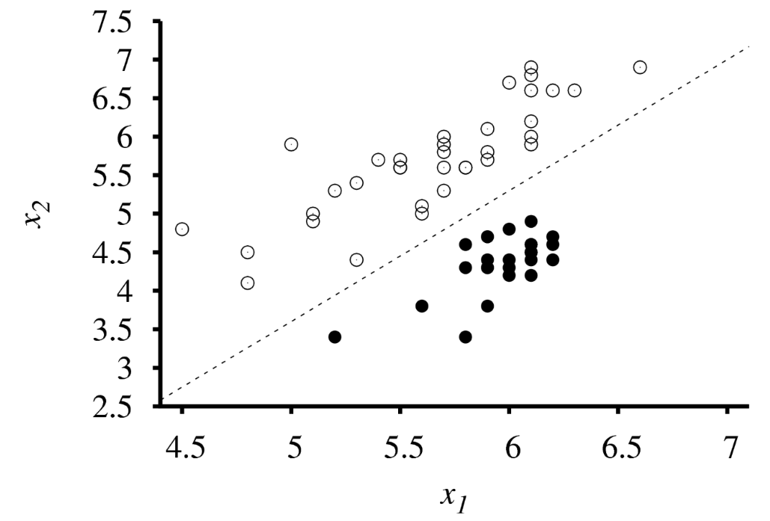
When Data Separable with Straight Line
Goal: Straight line that best separates white from black data
Source: Russell & Norvig
Notes:
Suppose that the data is labeled. The simplest type is binary: white or black. Learning is clearest if these can be separated by a straight line or plane surface, as in the figure. In that case, we find the “best” such line (or linear surface if in more than 2 dimensions). The reason for the separation of data is to deal with new data (the existing data needs no line because it is already labeled).

Slide 8
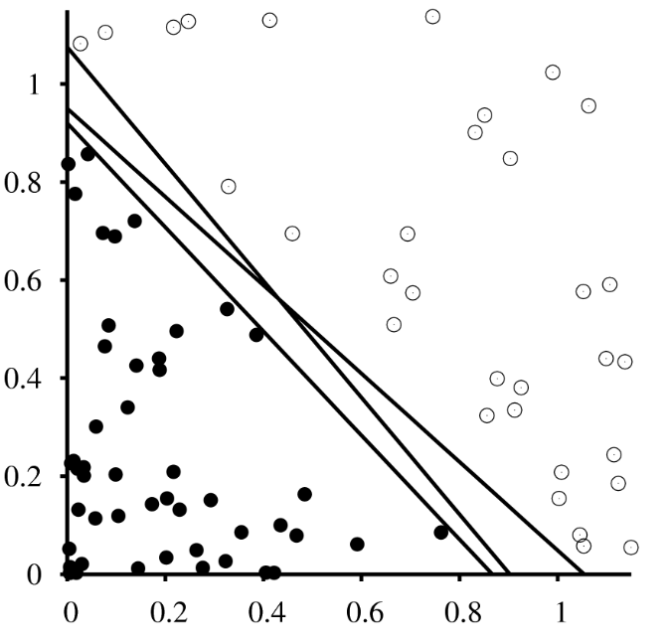
Possible Separators
Source: Russell & Norvig
Notes:
The figure shows several lines that separate the B&W data.

Slide 9
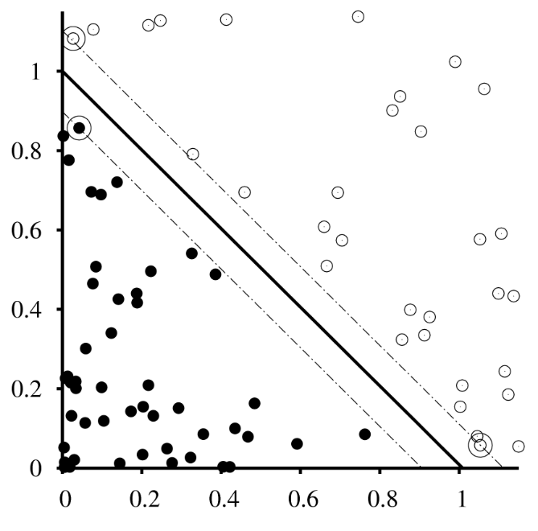
Separate via Maximum Margin Separator
Support vectors
Source: Russell & Norvig
Notes:
Assuming that a separating straight line exists, the support vector machine technique finds a straight line that gives as much separation as possible between the populations. This is a reasonable interpretation to “learning as much as possible.” To not do so would favor one over the other and would raise the potential for misclassification. The simplest version is learning from two 1-dimensional data points, as follows: suppose that you know about two customers, aged 30 and 40 respectively. The 30-year-old selected microfiber sheets from your linens website, the other did not. If you were forced to learn a classification from this data alone, the best you could do is to “learn” that shoppers under 35 probably pick microfiber and those over 35 not. 35-year-olds can be assigned to either at random.
For any separating line, the sum of the distance to the closest black datum and the closest white one is called the margin. This is the quantity we maximize.
We are assuming that there is a separating straight line. Using it, we can then identify a line that separates but intersects at least 2 black data. Likewise for two white nodes. This produces two straight lines, shown dashed, in red. One of these is selected—the one that yields the widest gap when applied to both black and white, by shifting as far as possible keeping in parallel. The separator is selected halfway between.

Slide 10
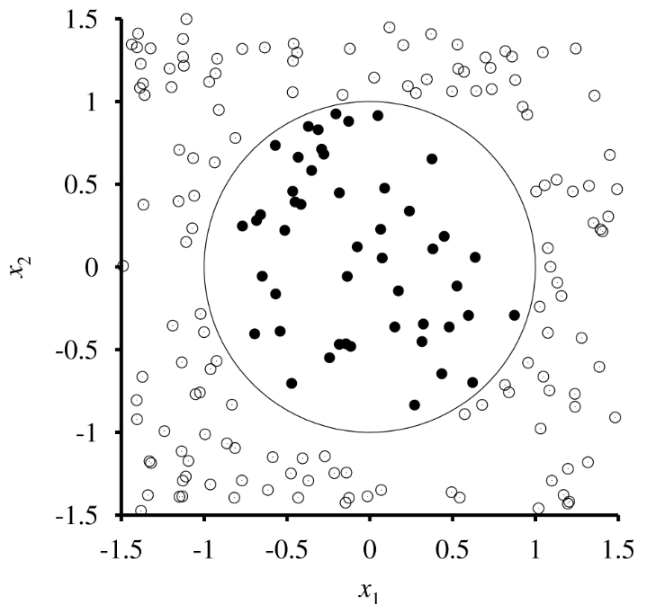
Data Not Necessarily Linearly Separable ...
Source: Russell & Norvig
Notes:
The goal of separation is to allow a quick way to classify new data. Straight-line separation is convenient but other shapes would do well, such as circles, etc., as long as computing inside-or-outside is fast enough. How does one determine a good shape? Sometimes there is special information about the data that suggests an appropriate shape.

Slide 11
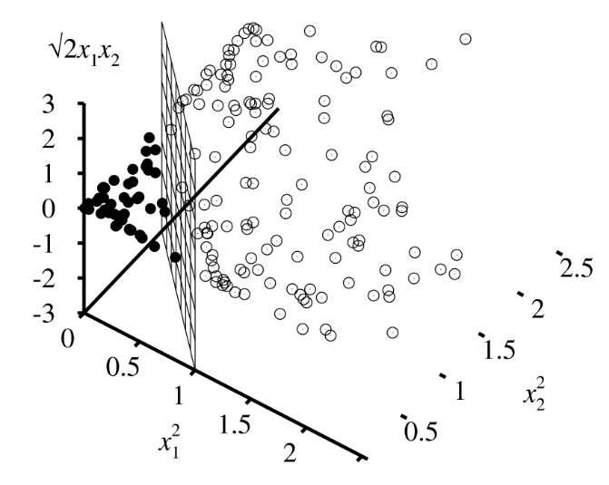
Linearly Separable in Higher-Dimensional Space
Source: Russell & Norvig
Notes:
The principle of SVM’s applies in higher dimensions, where the equations are of degree one (e.g., 3x + 2y + 4z – 9 = 0). In fact, given noisy, overlapping data, one looks for additional parameters (thus, dimensions) which achieve separation in a higher-enough dimensional space. This is outside the scope of the course.

Slide 12
k-Means Clustering
Notes:
SVM is supervised learning. k-Means Clustering is unsupervised: a non-neural net approach to classifying unlabeled data.

Slide 13
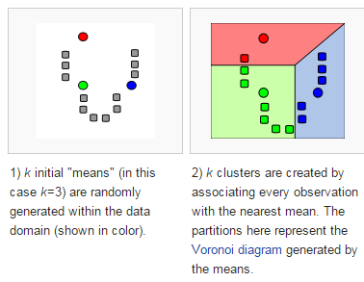
Given: Data + Number of Clusters (e.g., 3)
* http://en.wikipedia.org/wiki/K-means_clustering
Notes:
Here is a sample of unlabeled data. Suppose that we want it separated into 3 categories. An important feature of unsupervised learning in general are the choices we make like this, up front. Why 3? In fact there are ways of obtaining such a suggestion but they are beyond the scope of this course.

Slide 14
1. Select k “classifier” points at random
* http://en.wikipedia.org/wiki/K-means_clustering
Notes:
The first step is to select three of the data points at random. The colored three points are examples of random selection. We’ll call these three points “classifier” points.

Slide 15
2. Classify according to closest classifier point.
* http://en.wikipedia.org/wiki/K-means_clustering
Notes:
Every point is closest to one of the classifier points, so we can group all of the data according to which of the classifier points is closest. The groupings are called k-clusters.

Slide 16
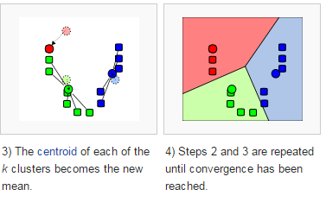
3. The classifier points are replaced by the centroids
* http://en.wikipedia.org/wiki/K-means_clustering
Notes:
Now we change the classifier points to the centroids (center of gravity) of the clusters identified so far.

Slide 17
Repeat steps 2 and 3 until set membership stabilizes
* http://en.wikipedia.org/wiki/K-means_clustering
Notes:
This process is continued until it stabilizes.

Slide 18
K-means Using TensorFlow
tf.compat.v1.estimator.experimental.KMeans( num_clusters, model_dir=None,
initial_clusters=RANDOM_INIT, distance_metric=
SQUARED_EUCLIDEAN_DISTANCE,
seed=None,
use_mini_batch=True, mini_batch_steps_per_iteration=1,
kmeans_plus_plus_num_retries=2, relative_tolerance=None, config=None,
feature_columns=None )
https://www.tensorflow.org/api_docs/python/tf/compat/v1/estimator/experimental/KMeans

Slide 19
k-Means (an Unsupervised Technique) Pro’s and Con’s
(+) Straightforward
(+) Frequently effective
(-) …
Notes:
k-means is relatively simple in concept, and can be quite effective.
On the other hand, how does one know a priori what k should be? There are sometimes clues; otherwise, one can try several values of k but using a relatively small random subset of the data, and compare separation characteristics of the results. The value which yields the best is a reasonable choice for k.
Another disadvantage is that there is much computation to be done at every iteration, which can cause unacceptably slow operation.
Note that k-means is unsupervised: we tell the system nothing about the nature of each datum.

Slide 20
k-Means (an Unsupervised Technique) Pro’s and Con’s
(+) Straightforward
(+) Frequently effective
(-) Selecting k
Try with small random samples
(-) Compute-intensive
Notes:
k-means is relatively simple in concept, and can be quite effective.
On the other hand, how does one know a priori what k should be? There are sometimes clues; otherwise, one can try several values of k but using a relatively small random subset of the data, and compare separation characteristics of the results. The value which yields the best is a reasonable choice for k.
Another disadvantage is that there is much computation to be done at every iteration, which can cause unacceptably slow operation.
Note that k-means is unsupervised: we tell the system nothing about the nature of each datum.

Slide 21
Learning and Intro to Neural Nets
Decision Trees
Support Vector Machines
Neural Nets
Architectures
Unsupervised learning
Supervised learning
Conclusions
Notes:
The most active technique in machine learning—as of the first half of 2018—is neural nets. In this module, we will review the types and then focus on unsupervised learning.

Slide 22
Application Examples
Recognizing handwriting
Input: sample pairs of script / print
Detecting credit card fraud
Predicting investments
Appraising real estate
Predicting hospital stays
...
Notes:
As the figure begins to show, the breadth of applications of neural nets (also referred to as “artificial neural nets” or “connectionist approaches”) is very large. Almost any area in which large amounts of data are known, can benefit from the application of neural nets.

Slide 23
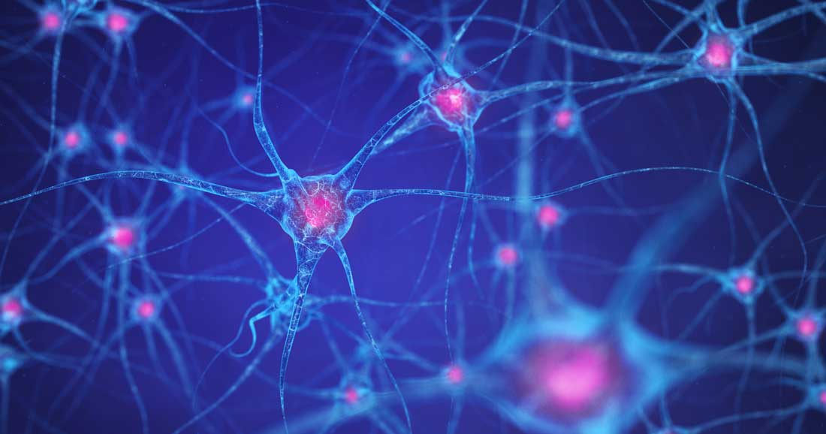
Working of the Brain
https://www.google.com/url?sa=i&url=https%3A%2F%2Fwww.dana.org%2Farticle%2Fhow-does-the-brain-work%2F&psig=AOvVaw3Domf1PDjWugEYLEc32F18&ust=1605096957467000&source=images&cd=vfe&ved=0CAIQjRxqFwoTCLD6hrP69-wCFQAAAAAdAAAAABAD

Slide 24
The Brain’s Neuron
synapse
dendrite
axon
combi-nation
process-ing
soma
Notes:
The architecture of neural nets is based on neurons in animal brains. A neuron is a cell which takes (electro-chemical) input from other neurons (including, possibly, itself), combines these, and then passes them via a synapse to other neurons. Synapses have varying degrees to which they transmit or inhibit signals. These change with time, reflecting learning.

Slide 25
An Artificial Neural Net
A system whose architecture is based on a simulation of neurons.

Slide 26
Questions
Where is “input”, “output”?
What’s it for?
Learning only?
Is there
“direction”?
What happens at each node?
Is topology enough?
Notes:
The figure contains a number of questions about neurons. The question “is topology enough?” asks “is it only the pattern of connectedness of neurons that counts?” We have partial, but practically usable answers to some of these questions.

Slide 27
Modelling Synapses
neuron i
neuron j
signal strength ?
signal strength s
signal s
w_{ji}
signal w_{ji}s
node i
node j
Notes:
The strength of a synapse is simulated with a scalar—a single number. Relatively high positive indicates that the output of the left neuron is more fully transmitted to the neuron on the right.

Slide 28
Modelling Neuronal I/O 1/2
* Output =
f ()
Process
Transfer function
weight w
weight w’
output o
output o’
Notes:
Each neuron is modeled as a function (the transfer function) that takes as input the output from other neurons, affected by synapses, and places its output (i.e., the same value) on every exiting edge*.
* Viewed as computer science, a neural network is a kind of graph, with vertices and edges.

Slide 29
Modelling Neuronal I/O 2/2
Process
Process
Process
* Output =
f (wo + w’o’)
*
*
*
Process
Neuron simulation
input wo+w’o’
Transfer function
weight w
weight w’
output o
output o’
Process
Process
Notes:
We almost always model the output o of a neuron by taking the product wo where w is theweight. The sum of these (in effect, a linear combination of the outputs) is taken as the input of the transfer function. This has proven to be effective but there are many factors to consider, including the precise nature of the transfer function.

Slide 30
Early History
1943: McCullough and Pitts “…neural nets”
Late 1950’s: Rosenblatt
perceptrons
single layer
step function
1969: Minsky and Papert
“Perceptrons” book: limitations
1960’s through 80’s: Widrow
1982: Hopfield N.A.S. paper
1986: Rumelhart & McClellan: “Parallel Distributed Processing” books
1986: Sejnowski and Rosenberg: NETtalk
1988 DARPA Study …
Notes:
The figure shows the early part of the long history of neural nets.
We will investigate perceptrons as a prelude to discussing modern-day neural nets.

Slide 31
1988 DARPA Study
1988: MIT/Lincoln Laboratory was directed by DARPA to establish a Terms of Reference to guide their Study and to assist DARPA in the overall management and execution of the neural net effort. The Study was initiated with a two-day symposium at Lincoln Laboratory.
Notes:
By 1988, DARPA had recognized the importance of neural nets.

Slide 32
Breakthrough
Steady by slow advancement (but increasing the layers did not seem to matter) until
availability of large data sets and
advent of deep neural nets.
Seminal paper: “ImageNet Classification with Deep Convolutional Neural Networks”
by Krizhevsky, Sutskever, and Hinton* (or see LeCun)
Showed how use layers to harness large volumes of data.
* Advances in Neural Information Processing Systems 25 (NIPS 2012)
Notes:
The field made steady by slow advancement but increasing layers did not seem to improve performance…until the availability of large data sets and the advent of deep neural nets.
A seminal paper was “ImageNet Classification with Deep Convolutional Neural Networks” by Alex Krizhevsky, Ilya Sutskever, and Geoffrey E. Hinton in Advances in Neural Information Processing Systems 25 (NIPS 2012). They showed how to successfully harness large volumes of data by means of layers. There are somewhat competing claims for importance with LeCun’s work.
We will return to deep learning.

Slide 33
Perceptron
x₀
w₀
x₁
w₁
y = 0 or 1
w₂
x₂
y₁ = 1 if w₀₁x₀ + w₁₁x₁ + w₂₁x₂ > 0
Notes:
A perceptron is a simple neural net in which the input nodes are pass-through’s, there is one output node, and the latter has the binary step transfer (or “activation”) function. Perceptrons were developed by Rosenblatt.

Slide 34

Perceptron Applicable to 2-category Classifications
(20,0,10)
Black: in front of plane.
Gray: behind plane.
Notes:
Since perceptron’s emit a binary output, they are appropriate for some classification tasks where the number of categories is 2. E.g., may be trained to classify points in three-dimensional space.

Slide 35
Using Perceptron to Classify
(20,0,10)
20
w₀
Example
input
0
w₁
0 or 1
w₂
10

Slide 36
Perceptron Learning Rule
Start with small, random w_{ij} on edge from input i to output j.
Train: w_{ij} ← w_{ij} – η(y_{i} – t_{j})∙x_{i}
w_{ij}
input i
output j
updated w_{ij}
prior w_{ij}
learning rate
Notes:
In that case, the perceptron learning rule can be tried.
We start with a random set of weights and a number η that reflects the learning rate.
We repeatedly do the following:
run the nn
adjust each weight according the formula shown.
It changes the weight by a fraction of the corresponding input if the target differs from the actual.

Slide 37
Perceptron Learning Rule
Start with small, random w_{ij} on edge from input i to output j.
Train: w_{ij} ← w_{ij} – η(y_{i} – t_{j})∙x_{i}
Output with prior weight
target
updated w_{ij}
prior w_{ij}
learning rate
error
proportioned
Notes:
In that case, the perceptron learning rule can be tried.
We start with a random set of weights and a number η that reflects the learning rate.
We repeatedly do the following:
run the nn
adjust each weight according the formula shown.
It changes the weight by a fraction of the corresponding input if the target differs from the actual.

Slide 38
Example*: Learn Logical OR
Input 1 | Input 2 | Truth Value
0 | 0 | 0
0 | 1 | 1
1 | 0 | 1
1 | 1 | 1
1
Desired
output: 1
Desired output: 0
1
* “Machine Learning” by Marsland, p49
Notes:
The figure shows what a perceptron confronted with learning logical or for binary inputs. The problem is that when the inputs are (0, 0), the output is always zero. When you try to apply the learning formula
w_{ij} ← w_{ij} – η(y_{i} – t_{j})∙x_{i}
This just gives … (new)w_{ij} ← (prior)w_{ij} , and nothing is learned. The problem of zero (or very small values) is a common one in neural nets.

Slide 39
Example*: Learn Logical OR
Input 1 | Input 2 | Truth Value
0 | 0 | 0
0 | 1 | 1
1 | 0 | 1
1 | 1 | 1
1
Desired
output: 1
Desired output: 0
Problem:
when input x = (0, 0),
output = zero.
w_{ij} ← w_{ij} – η(y_{i} – t_{j})∙x_{i} gives … (new)w_{ij} ← (prior)w_{ij} !
1
* “Machine Learning” by Marsland, p49
Notes:
The figure shows what a perceptron confronted with learning logical or for binary inputs. The problem is that when the inputs are (0, 0), the output is always zero. When you try to apply the learning formula
w_{ij} ← w_{ij} – η(y_{i} – t_{j})∙x_{i}
This just gives … (new)w_{ij} ← (prior)w_{ij} , and nothing is learned. The problem of zero (or very small values) is a common one in neural nets.

Slide 40
Introduce Bias Node …
1
Desired
output: 1
… to learn, with
(possibly) all-zero inputs
Desired output: 0
1
Fixed: -1 →
Notes:
This can be remedied when a bias node is introduced, as in the figure. This is a node with fixed input (but not fixed weight on its edge). As long as the fixed input is not zero, its value may not matter. The NN still operates with two effective inputs and one output.

Slide 41
Randomly Select Initial Weights
Begin with
random weights:
Fixed: -1 →
w₀ = -0.05
w₁ = -0.02
w₂ = 0.02
Notes:
The figure shows the learning process, starting with the random weights shown.

Slide 42
Train with First I/O Datum
… (0,0)
Desired output: 0
Fixed: -1
w₀ = -0.05
w₁ = -0.02
in: 0.05
0
1
0
w₂ = 0.02
Notes:
These produce an output of 1 for the input (0, 0).

Slide 43
Adjust
w₀ ← w₀ – 0.25(1 – 0)∙(-1) = 0.2
w₁ ← w₁ – 0.25(1 – 0)∙0 = -0.02
w₂ ← w₂ – 0.25(1 – 0)∙0 = 0.02
Desired output: 0
Fixed: -1
w₀ = 0.2
w₁ = -0.02
in: -0.18
0
0
1
w₂ = 0.02
Notes:
Using (0, 0) → 1, we train the weights and find that the new weights do yield 0 on (0, 0).
We move on to the next training pair. The input (0, 1) produces the output 0.

Slide 44
Adjust Again
Desired output: 1
Fixed: -1
w₀ = 0.2
w₁ = -0.02
in: -0.18
0
0
1
w₂ = 0.02
w₀ ← w₀ – 0.25(0 – 1)∙(-1) = -0.05
w₁ ← w₁ – 0.25(0 – 1)∙0 = -0.02
w₂ ← w₂ – 0.25(0 – 1)∙1 = 0.27
Notes:
We use this pair to train the nn for one generation, using the update formula as shown.

Slide 45
Result on (0, 1)
Desired output: 1
Fixed: -1
w₀ = -0.05
w₁ = -0.02
in: 0.32
0
1
1
w₂ = 0.27
Notes:
The new weights give the correct output of 1 on (0, 0). They also behave correctly on (0, 0) and (1, 1).

Slide 46
Example: Learn Exclusive OR(?!)
Desired output: 0
Input 1 | Input 2 | Truth Value
0 | 0 | 0
0 | 1 | 1
1 | 0 | 1
1 | 1 | 0
1
Desired output: 0
1
* “Machine Learning” by Marsland, p49
Notes:
Minsky and Papert showed that perceptrons cannot be trained to recognize the exclusive or binary operation, where the output for (1, 1) is 0. (You can see that no straight line could be found that separated black from white if a zero output was desired at (1,1).)

Slide 47
A TensofFlow Implementation (but not the Perceptron Learning Rule)
https://www.tutorialspoint.com/tensorflow/tensorflow_single_layer_perceptron.htm

Slide 48
Learning and Intro to Neural Nets
Decision Trees
Support Vector Machines
Neural Nets
Architectures (Models)
Unsupervised learning
Supervised learning
Conclusions
Notes:
In this section we explore overall architectures for neural nets.

Slide 49
When to Use Neural Nets
No model is known
Input (/Output) data exists
convertible to numerical form
Time is available for learning
Notes:
The figure reviews the usual reasons that a neural net is a good candidate ML approach.

Slide 50
Neural Net with Feedback
Notes:
A neural net has feedback if it contains at least one cycle. Otherwise it is called a feedforward neural net. These are most common as of 2018.

Slide 51
Architectures (after Lawrence)
with feedback
feedforward
Hopfield
BAM
ART
Notes:
Lawrence decomposed neural nets into the tree of possibilities shown. Hopfield nets are a influential example of NN's with feedback. Feedforward NN's can be classified as to whether or not they use step functions (as in perceptrons). In supervised learning we know the required output for each input in the training set. In unsupervised NN's we have merely data (which can be thought of as input) but nothing else. This is a bit like landing on Pluto, discovering thousands of rocks, and knowing nothing significant about any of them.

Slide 52
Architectures (after Lawrence)
with feedback
feedforward
Hopfield
BAM
ART
Non-step
Step*
Adaline
Perceptron
unsupervised
supervised
Kohonen ...
Back-propagation ...
* Also referred to as “linear”
Notes:
Lawrence decomposed neural nets into the tree of possibilities shown. Hopfield nets are a influential example of NN's with feedback. Feedforward NN's can be classified as to whether or not they use step functions (as in perceptrons). In supervised learning we know the required output for each input in the training set. In unsupervised NN's we have merely data (which can be thought of as input) but nothing else. This is a bit like landing on Pluto, discovering thousands of rocks, and knowing nothing significant about any of them.

Slide 53
Learning and Intro to Neural Nets
Decision Trees
Support Vector Machines
Neural Nets
Architectures
Unsupervised learning
Supervised learning
Conclusions
Notes:
We start by discussing learning from unlabeled data (the “rocks on Pluto” problem). What kinds of things can be learned in cases like that?

Slide 54
Unsupervised Learning
INGREDIENTS
Neural Net
Framework
Inputs
Ref: Marsland Cpt 14
Notes:
The figure shows what goes into unsupervised learning, and what comes out of it. The product is a neural net that performs classification but the neural net does not come with an explanation of what it classifies. To determine its usefulness is an empirical process. It is either useful in practice or it is not.

Slide 55
Unsupervised Learning
INGREDIENTS
PRODUCT
Neural Net
Framework
Neural Net
which Classifies
Inputs
Ref: Marsland Cpt 14
Notes:
The figure shows what goes into unsupervised learning, and what comes out of it. The product is a neural net that performs classification but the neural net does not come with an explanation of what it classifies. To determine its usefulness is an empirical process. It is either useful in practice or it is not.

Slide 56
Principles of Unsupervised Learning
“If an action is followed by a satisfactory state of affairs, or an improvement in the state of affairs,
then …
(barto, http://www.cs.umass.edu/csinfo/announce/barto_idea.html)
Notes:
The most commonly used approach to unsupervised learning is Hebbian or reinforcement learning, as described in the figure. The term Pavlovian is sometimes loosely used for it.

Slide 57
Principles of Unsupervised Learning
“If an action is followed by a satisfactory state of affairs, or an improvement in the state of affairs,
then the tendency to produce that action
is strengthened;
otherwise that tendency is weakened.”
(barto, http://www.cs.umass.edu/csinfo/announce/barto_idea.html)
Notes:
The most commonly used approach to unsupervised learning is Hebbian or reinforcement learning, as described in the figure. The term Pavlovian is sometimes loosely used for it.

Slide 58
Principles of Self-Organization*
Connections that fire repeatedly, strengthen
Limitation of resources causes competition among synapses
Synapse modifications tend to have cooperative effects
Order and structure in weight patterns lead to self-organization
* Adapted from von der Malsburg “An Introduction to Neural …,” Academic Press
Notes:
The figure translates the reinforcement principle into operational term for neural nets. The ML practitioner has to specify something about what it to be learned such as the number of clusters expected—in other words, has to supply something architectural about the intended system.

Slide 59
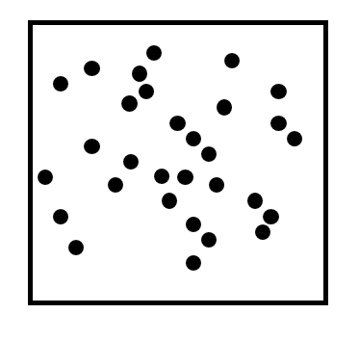
Input (2D Example)
Notes:
We have already discussed an approach to unsupervised learning: k-means. We’ll look at the some kind of problem but this time we will use neural nets. Suppose that we give the 2D data shown to an unsupervised learning system. This implies that we want the data classified. We usually specify a maximum number of clusters.

Slide 60
Effect of Kohonen Map
Notes:
If we specify (a maximum of) 17 clusters, the result at right would be a feasible outcome.

Slide 61
Competitive Learning Goal (3D Example)
(1) Example goal: separate input into four clusters
(2) Select four outputs.
(We must update weights based on input alone.)
o₁
1
4
7
7
1
4
2
7
0
x₁
o₂
x₂
o₃
x₃
o₄
Notes:
Let’s presume that we want (up to) 4 categories in 3-dimensional data. To deal with this kind of problem with a Kohonen net, we create a no-hidden-node neural net in which the input has enough dimensions and the output consists of 4 nodes (the number of categories).

Slide 62
Normalization
Notes:
We will need to “normalize.” Normalizing data means to restrict their range in space while at the same time maintaining their relative spatial relationships. There are many ways to do this.
Normalization is a fairly strong requirement. It often means to give all of the vectors the same magnitude—meaning in 2D that they all reside on the same sphere (which we might as well take to be the unit sphere).

Slide 63
Competitive Learning Networks
(3) Normalize* input; select normalized random weights.
* sum of values = the count
w₁₁
o₁
= x₁w₁₁ + ...
x₁
o₂
(x₁, x₂, x₃)
x₂
(w₁, w₂, w₃)
o₃
x₃
o₄
normalize
normalize
Notes:
Both the inputs and the weights are normalized.

Slide 64
Consider Each x (input) Separately
x₁
w₃
{
x =
x₂
o₃
x₃
Notes:
Notice that the inputs and the weight vectors associated with each output have the same dimensionality (3 in this case). Since they have all been normalized, they “cohabit” the same region of n-dimensional space even though inputs and weights are really different kinds of things. This is Kohonen’s essential observation. In the following, we ignore the normalization requirement for now in order to make the illustrations clearer. We will return to it later.

Slide 65
Kohonen’s Technique Visualized
w_{i} “supports” o_{i}
w_{i}’s are in same space as x’s
Notes:
The figure summarizes the situation.

Slide 66
Kohonen’s Technique Visualized
For each x: If w_{k} is closest of all w_{i}’s to x, move it closer.
= input
w₃
x
w₂
Notes:
The essence of Kohonen’s technique is to move the weights towards their nearest cluster by moving each weigh in the direction of the input vector closest to it.

Slide 67
Competitive Learning Rule
For w_{i} closest to x (by Euclidean measure), update:
w_{i}( t + 1 ) = w_{i}(t) + η[ x(t) - w_{i}(t) ]
e.g., w_{i2}( t + 1 ) = w_{i2}(t) + η[ x(t) - w_{i2}(t) ]
-- in normalized manner.
x
w_{i2}
2D: move w_{i} towards x.
w_{i2}
x
Notes:
This process is easiest to see in one dimension. The learning rate is η. If η = ½, this means that each cycle moves each w_{i} halfway towards the closest x. Sometimes a degree of noise is introduced so that once such a move has been made, a different node from the same cluster may then be closest.

Slide 68
Example: Before Accounting for x₇₇₄
w₁
shortest
w₂
x₇₇₃
x₇₇₄
x₇₇₅
Notes:
The figures show the movement of a weight w₁.

Slide 69
After Accounting for x₇₇₄
w₁
w₂
x₇₇₃
x₇₇₄
x₇₇₅

Slide 70
Before Accounting for x₇₇₅
w₁
w₂
x₇₇₃
x₇₇₄
shortest
x₇₇₅
x₁

Slide 71
After Accounting for x₇₇₅
w₁
x₇₇₃
x₇₇₄
w₂
shortest
x₇₇₅
x₁

Slide 72
Effect is to Place w’s Near x-Clusters
To identify cluster, find closest w.
= each input
w₂
w₃
x
Notes:
At the end of this process, particularly if some noise is added, the weights are likely to be more or less within the clusters and the neural net is ready to classify all input. However, if you try this out with simple data you may find it actually fails to classify because …

Slide 73
2D Example (Highest o Wins)
Example 1: x not in cluster represented by w
x
w
wx = (1, 0)*(-1, 0) = -1
Example 2: x in cluster represented by w
wx = (0, -1)*(0, -1) = 1
x
w
Notes:
… you may have forgotten to normalize the data and weights. Here, we have normalized 1-dimensional x and w values so that they all exist on a sphere. (This appears to be 2D but it’s actually 1D since it is all on a (curved) line.)
In the first example, w represents a cluster and x is not part of it. The “inner product” (the usual linear combination of weights and values in a neural net), which is the output value of the Kohonen net, wx, is -1.
In the second example, w represents a cluster and x is part of it. The inner product wx is 1.
This difference suggests (we are not mathematically proving here) that, in normalized space, the closer a weight vector is to a cluster, the more distinguished its application in the neural net.

Slide 74
Kohonen Feature Maps
Type of competitive learning
Update weights “smoothly”
also update weights in a neighborhood
decrease size of neighborhood over time
Notes:
Kohonen nets are a type of competitive learning in that different clusters “compete” to have a weight represent them. These notes made reference to noise as a way to (smoothly) move a weight to a cluster but avoid approaching only the nearest vector. There are several other ways to encourage the weight to nestle in the cluster. A common way is to account for more than the closest node—to include all nodes within a radius, but to decrease the radius as generations progress.

Slide 75
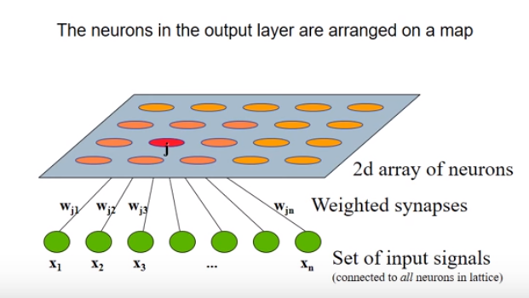
Demonstration
https://www.youtube.com/watch?v=abF_FdCb5OI
Notes:
The demonstration at https://www.youtube.com/watch?v=-6a7LATC-9g consists of many square cells, each representing a data point. You can think of the data as 3-dimensional, converted to (R, G, B), and the output as having two nodes, representing the x- and y-coordinate of the cell.

Slide 76
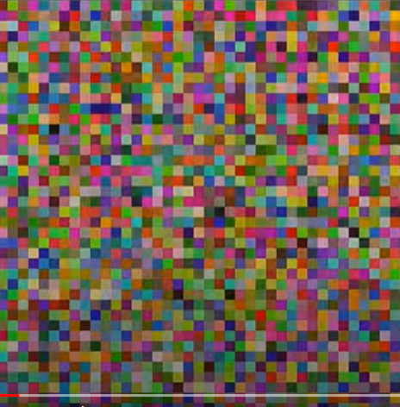
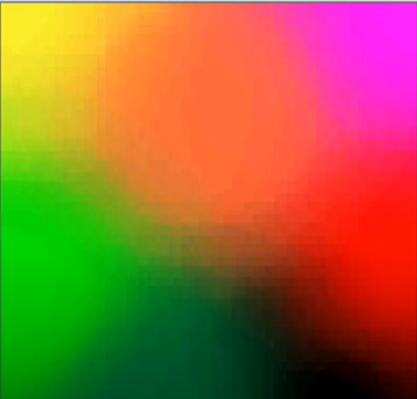
Kohonen Net Graphic
o₁
o₂
o₃
o₄
https://www.youtube.com/watch?v=-6a7LATC-9g

Slide 77
Application to Recommendation Systems
Highly vulnerable to attacks:
Competitors bias the system
-create fake profile and inject into recommender
Approach: “increasing the number of clusters we get the expected results as the attack profiles will get isolated from the genuine profile.”
Securing collaborative filtering recommender system using Kohonen Net clustering technique
http://ieeexplore.ieee.org/document/7019264/ P. Anjali Devi and L. Anitha International Conference on
Advanced Communication Control and Computing Technologies (ICACCCT), 2014
Notes:
The figure mentions a paper in which fake profiles are recognized. This has application to various security problems. What is interesting is the injection of fake profiles in order to promote appropriate clustering around them the identification of such clusters as fake.

Slide 78
Example Application: Medical Diagnosis 1/3
Results: … a Kohonen map is capable of classifying the patients as having glomerular or tubular disease with a higher sensitivity and predictive value than the nephrologists and the rule-based system, and that the best classification was performed by the hybrid system: …
D.K. Swift and C.H. Dagli Proceeding (411) Artificial Intelligence and Applications - 2004
Notes:
The figure shows a medical application. It demonstrates the possibility of self-organizing maps as sometimes having better capabilities than humans or explicit rules. Compared results are shown in the following figures.

Slide 79
Example Application: Medical Diagnosis 2/3
“Results: … sensitivity and predictive value for the diagnosis 'glomerular' respectively
100 and 88% for the network with most adequate results
90 and 83% for the nephrologists,
90 and 95% for the rule-based system, and
95 and 96% for the hybrid system

Slide 80
Example Application: Medical Diagnosis 2/3
Sensitivity and predictive value for diagnosis 'tubular'
50 and 100% for the neural networks,
31 and 45% for the nephrologists,
81 and 68% for the rule-based system, and
87 and 82% for the hybrid system

Slide 81
Example Application: Medical Diagnosis 3/3
Conclusion: … a Kohonen map is capable of classifying the patients as having glomerular or tubular disease with a high sensitivity and predictive value.
The rule-based system performs worse than the neural networks.
The most adequate results were obtained with the hybrid system.”
D.K. Swift and C.H. Dagli Proceeding (411) Artificial Intelligence and Applications - 2004

Slide 82
Learning and Intro to Neural Nets
Types of Learning
Support Vector Machines
Neural Nets
Architectures
Unsupervised learning
Supervised learning
Conclusions
Notes:
The rest of our work will concern supervised (or labeled) learning.

Slide 83
Supervised Learning
Given: set of input/output vector pairs
e.g. (16.2 , -1.34 , 112.3 ), (7.0 , -3.0 )
Required: a net which yields these results
(or almost)
-- and interpolates
Gives outputs “in between” for inputs “in between”
Method: adjust weights
Notes:
The basic idea is to get the neural net to behave as desired on the training set by adjusting the weights. The (reasonable) assumption is that if the training set contains enough diverse data in sufficient quantity, input not in the training set will behave appropriately.

Slide 84
Feedforward n-layer nets
2.1
- 2.2
Output Layer
w
w
w
w
w
w
Hidden Layer(s)
w
w
w
w
w
w
w
w
w
Input Layer
16.2
-1.34
112.3
Notes:
Modern neural nets contain at least one layer that is neither input nor output (hidden layers).

Slide 85
Example: Data Mining for Threats
Terrorist
threat
index
Event index
level
w
w
w
w
w
w
w
w
w
w
w
w
w
w
Move
frequency
Yemen visit
frequency
Event
size
Notes:
The figure shows an imagined neural net for assessing terrorist threats to an event for a given individual. One issue is finding a way to represent the inputs appropriately as (numerical) vectors.

Slide 86
Binary (Threshhold) Transfer (Activation) Functions
Threshold
1
0
w1*out1 + w2*out2
w1
w2
out1
out2
Notes:
Transfer (or “activation”) functions are generally bounded: in other words, not allowed to output values of unlimited size. This is biologically faithful: no brain neuron can output a signal that could be tens, hundreds, or thousands of volts etc. For convenience, the bounds are often 0 and 1 throughout.
The simplest transfer function is a binary (threshold) function which jumps at an input value from 0 to 1 but it otherwise constant. The problem with this function is that it is not differentiable: calculus cannot be applied to it, whereas the computation of well-fitting

Slide 87
ReLU (Rectified Linear Unit ) Functions
1
0
Notes:
A fairly commonly used transfer function is the ReLU function, shown in the figure. Basically, it is the closest we can come to a straight line—but with the constraint that it must be bounded.
A problem with this function is that, strictly speaking, it is not differentiable, and so calculus cannot be applied to it.

Slide 88
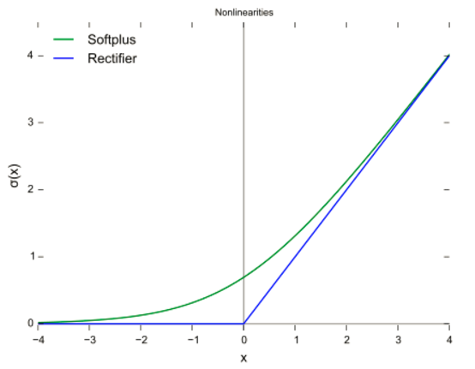
Approximating ReLU Differentiably
Notes:
Although ReLU activation functions are not differentiable at a point, they can be approximates by the softplus function f(x)= ln(1+exp(x)) if necessary, although this does not take care of the upper bound.

Slide 89
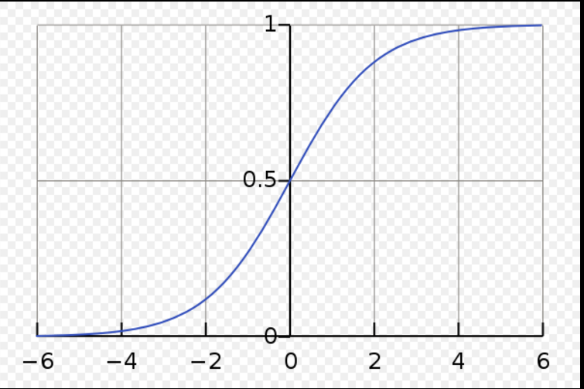
Logistic Activation Function
Output: f ( input )
-- where input = SUM ( w * output ) + ( bias constant )
-- and f (x) = 1 / ( 1 + exp( -kx ) )
Sigmoid
shape
https://en.wikipedia.org/wiki/Logistic_function#/media/File:Logistic-curve.svg
Notes:
Sigmoid (shaped) activation functions are ideal in many ways. A common one is the logistic function shown in the figure. It is nicely bounded and differentiable.
Other activation functions can be seen in the table at https://en.wikipedia.org/wiki/Activation_function. The hyperbolic tan function (the inverse of tan() in trigonometry) is another useful sigmoid function.

Slide 90
Summary
Neural Nets are interpolation devices
Based on known input/output data
Slow to learn (depends on architecture)
Fast to execute (depends on architecture)
Effective but lack explanation
Many promising applications
Use when defined model not required

